Slide 1
Urban Sound Classification
A comparison of MLP, RNN, and CNN

Slide 2
Problem
Classification of sounds encountered in an urban environment like running ACs, idling cars and gunshots.
Approaches taken:
Multilayer Perceptron
Recurrent Neural Network
Convolutional Neural Network

Slide 3
Dataset
UrbanSound8K
Classes = {air_conditioner, car_horn, children_playing, dog_bark, drilling, engine_idling, gun_shot, jackhammer, siren, street_music}
Folds = 10
Format = .WAV
File Count = 8732

Slide 4
Preprocessing
WAV files need to be preprocessed for feature extraction.
Load WAV to time series
Features = {MFCC, Tonnetz, Mel-Scaled Spectrogram, Chromagram, Spectral Contrast}
Implemented using librosa
Train/Test split
One-Hot

Slide 5
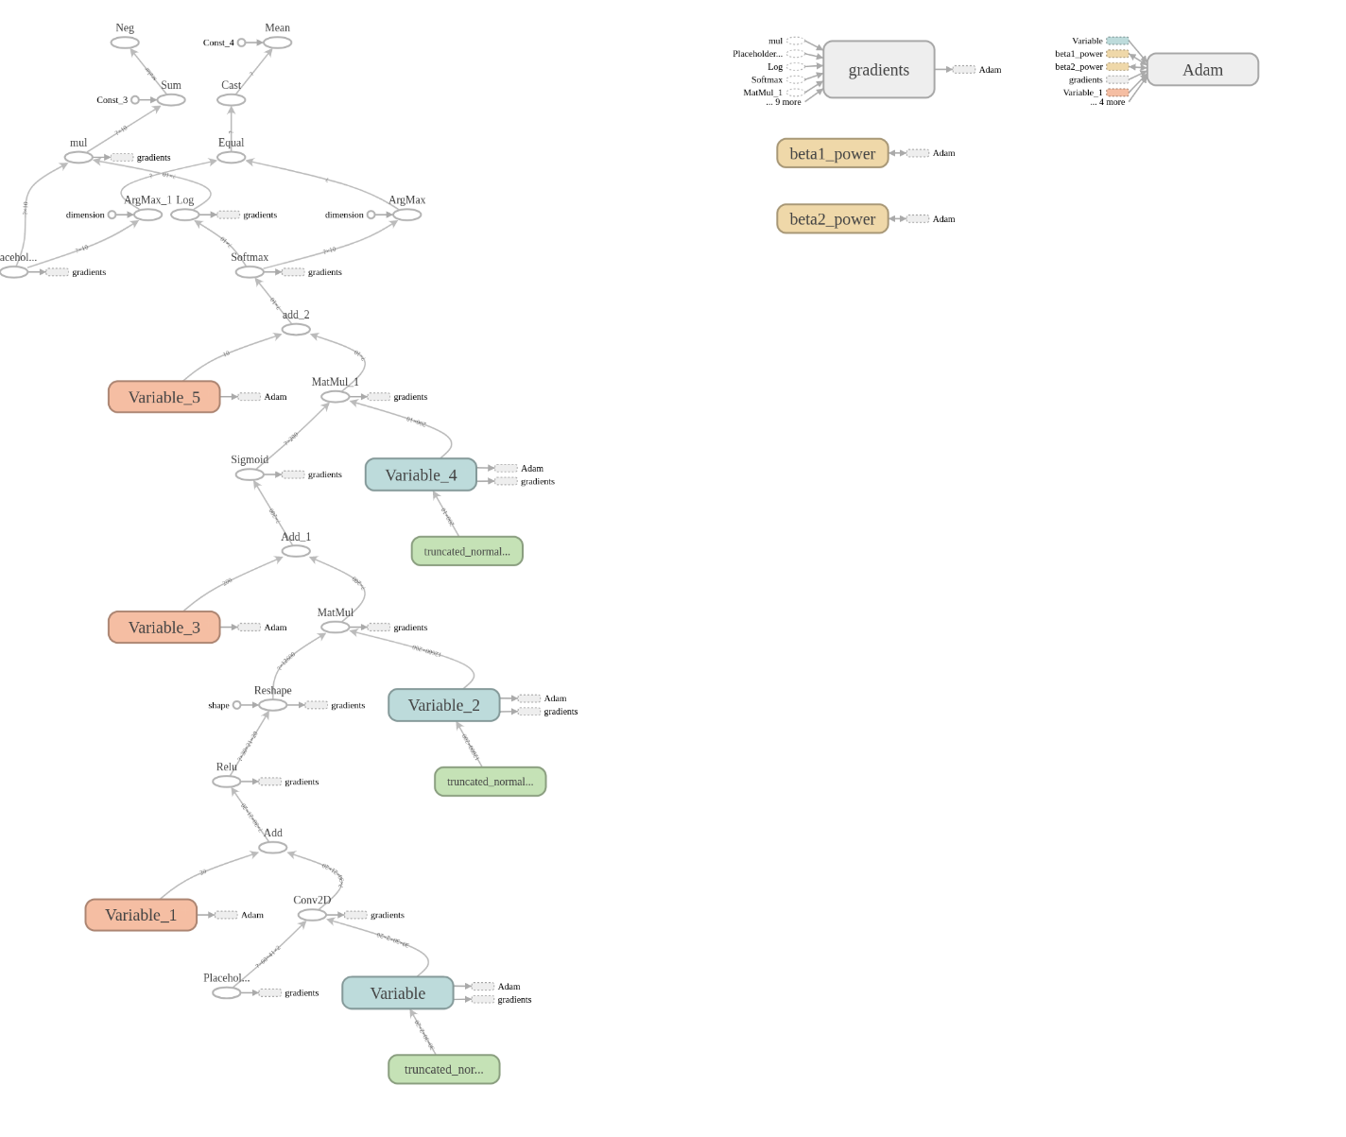
Architecture (CNN)

Slide 6
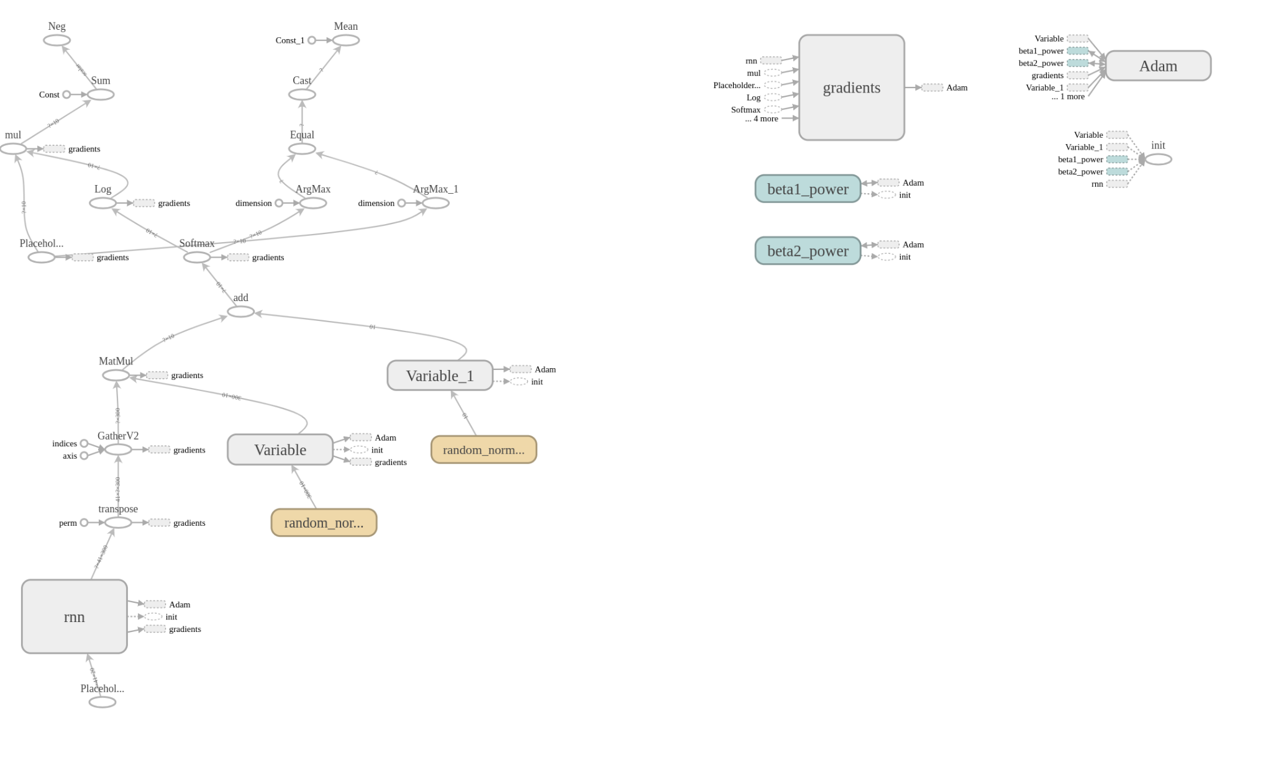
Architecture (RNN)

Slide 7
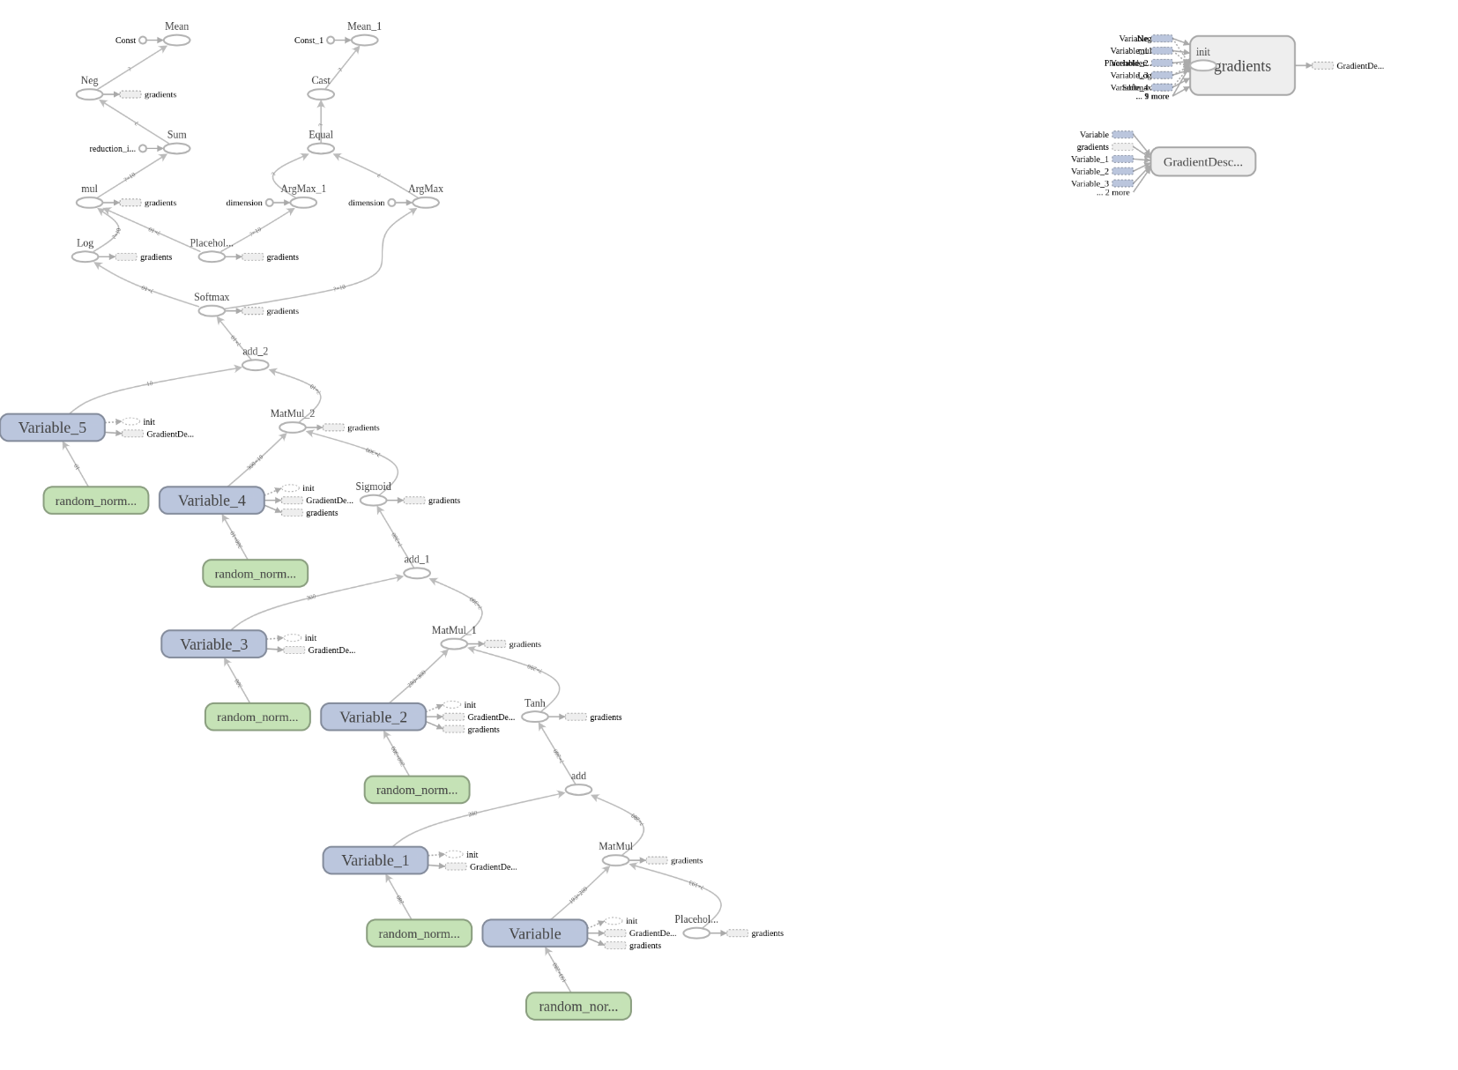
Architecture (MLP)
Notes:
Loss, Optimizer

Slide 8
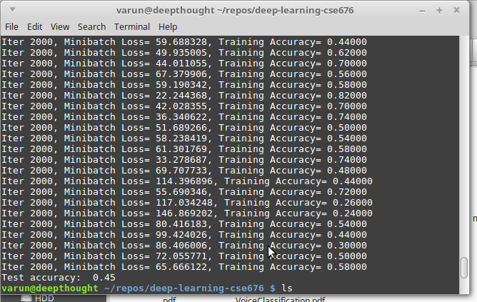
Results (RNN)

Slide 9
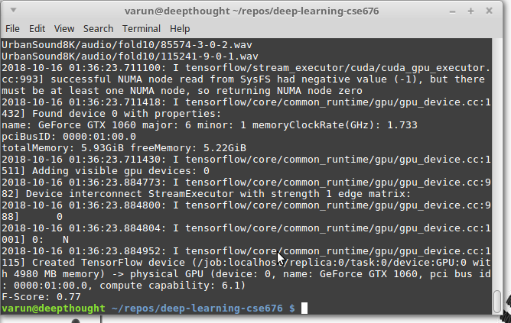
Results (MLP)

Slide 10
Improvements.
Since the RNN and CNNs could not achieve the kind of accuracy we expected. We would like to suggest some improvements.
If CNNs are too deep it leads to features that don’t make much sense. For this reason we make use of ResNets.
Thus in our case the conv window size is not suitable for the application. Having a window size of 30*30 is a bad idea, as it does not account for inherent difference between a regular image and spectrogram.
Spectrogram has a horizontally continuous nature that pose a unique challenge to accommodate, that a 30 size kernel does not.
We faced technical issues while implementing RNN. Thus the architecture needed some alteration. That might have caused the accuracy to drop significantly.

Slide 12
Confusion Matrix
From the confusion matrix we can infer that air conditioning, jackhammer and engine idling were classified very accurately.
While the barking dogs and gun shots were the worst classified.
This also provides us with insights of the nature of these sounds and that whether these are uniquely identifiable.

